Slide 1
IOT BASED RIVER WATER QUALTIY MONITORING SYSTEM USING IBM WATSON
Team Name:
The_coders
Team Members:
R.Swetha
Sushma Thota
N.Mary Satya Shree

Slide 2
InTRODUCTION:
(Problem Statement)
Water pollution is one of the biggest fears for the green globalization. In order to ensure the safe supply of the drinking water the quality needs to be monitor in real time. In this project we present a design and development of a low cost system for real time monitoring of the water quality in IOT(internet of things).The system consist of several sensors used to measure physical and chemical parameters of the water. The parameters such as humidity, temperature(atmospheric), turbidity, temperature of the water can be measured. The measured values from the sensors can be processed by the core controller. The NodeMCU model can be used as a core controller. Finally, the sensor data can be viewed on IBM Watson Cloud database using WI-FI Module.

Slide 3
Project WORKING PROCESS:
In this project we intend to present the design and development of a low cost system for real monitoring of water quality in an IoT environment. The system consists of several sensors which are used for measuring physical and chemical parameters of water.
Using this system a person can detect pollutants from a water body from anywhere in the world. We can monitor the water quality parameters by using some sensors and these sensor parameters are sent to the IBM Watson cloud and stored in the data base. These parameters are visualized in the User Interface which is created using Node Red of IBM Watson platform. Whenever the water quality is not good we can send notifications to authorities through the third party services.

Slide 4
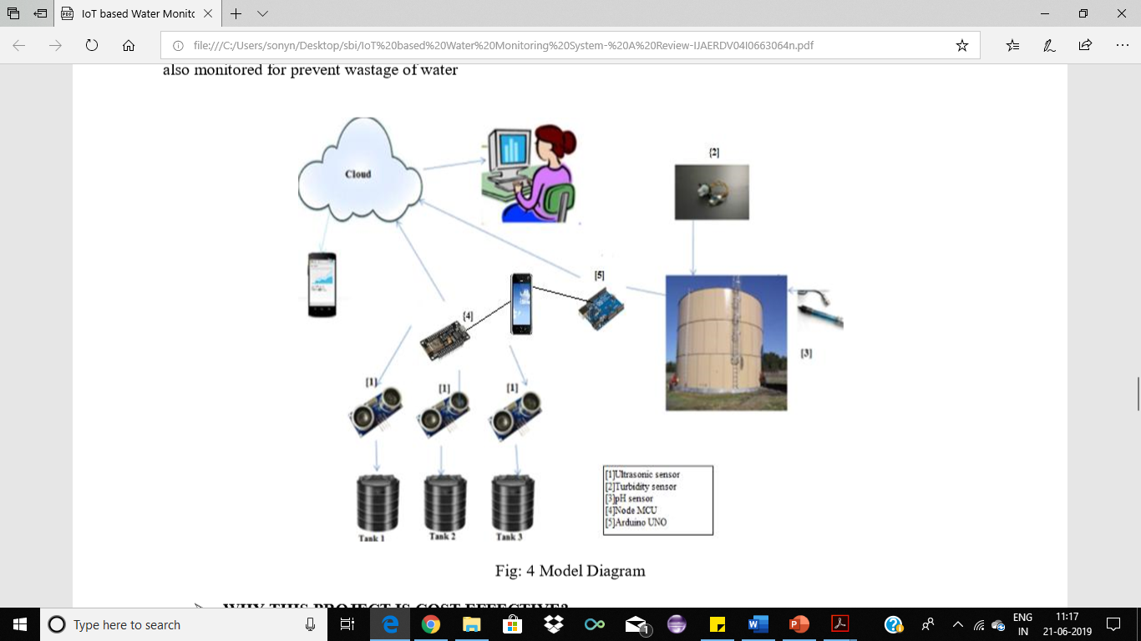
Complete Project Working Process

Slide 5
About Components Used:
Hardware
Node MCU
Turbidity sensor
Water Temperature sensor
Temperature & Humidity sensor(DHT11)
BreadBoard
Basic Sheild
Softwares
Arduino IDE
Node-RED
IBM Watson Cloud Services

Slide 6
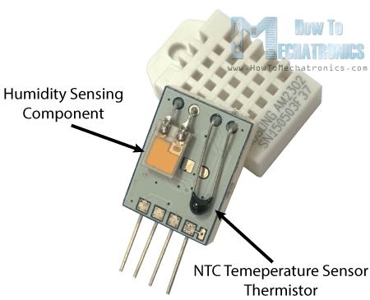
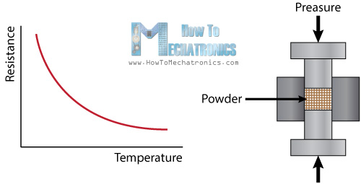
DHT11 sensor
(Specifications,Working principle,Datasheets)
Working Principle: The DHT11 Temperature and Humidity Sensor features a calibrated digital signal output with the temperature and humidity sensor capability. It is integrated with a high-performance 8-bit microcontroller. Its technology ensures the high reliability and excellent long-term stability. This sensor includes a resistive element and a sensor for wet NTC temperature measuring devices. It has excellent quality, fast response, anti-interference ability and high performance. They consist of a humidity sensing component, a NTC temperature sensor (or thermistor) and an IC on the back side of the sensor. For measuring humidity they use the humidity sensing component which has two electrodes with moisture holding substrate between them. So as the humidity changes, the conductivity of the substrate changes or the resistance between these electrodes changes. This change in resistance is measured and processed by the IC which makes it ready to be read by a microcontroller.
Specifications
Supply Voltage: (3-5) V
Temperature range :0-50 °C error of ± 2 °C
Humidity :20-90% RH ± 5% RH error
Interface: Digital

Slide 7
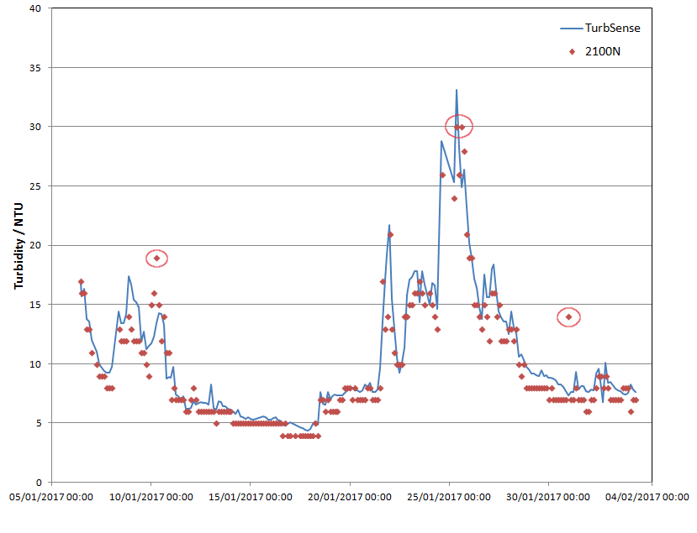
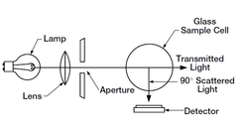
Turbidity sensor
(Specifications,Working principle,Datasheets)
Working Principle: Water flows between the two projections of the transparent plastic can. These projections house the photo transistor and the photodiode respectively. The phototransistor emits light rays that are supposed to reach the photodiode. These light rays come across the water flow and lose their path when they meet any suspended particle in the water. As a result, the light received at the photodiode is less in amplitude when compared to that when it was emitted. This difference in amount of light sent and received is conveyed to the micro controller operating the sensor and decisions are taken in accordance to that. For instance, in case of more turbid water, a dishwasher will increase water cycles and would less recycle the water.
Specifications:
Operating Voltage: 5VDC.
Current: 30mA (MAX).
Operating temperature: -30 ° C to 80 ° C.
Compatible with Arduino, Raspberry Pi, AVR, PIC, etc.
Detects and verifies water quality.
Digital and analog output;
Trimpot for sensitivity adjustment.

Slide 8
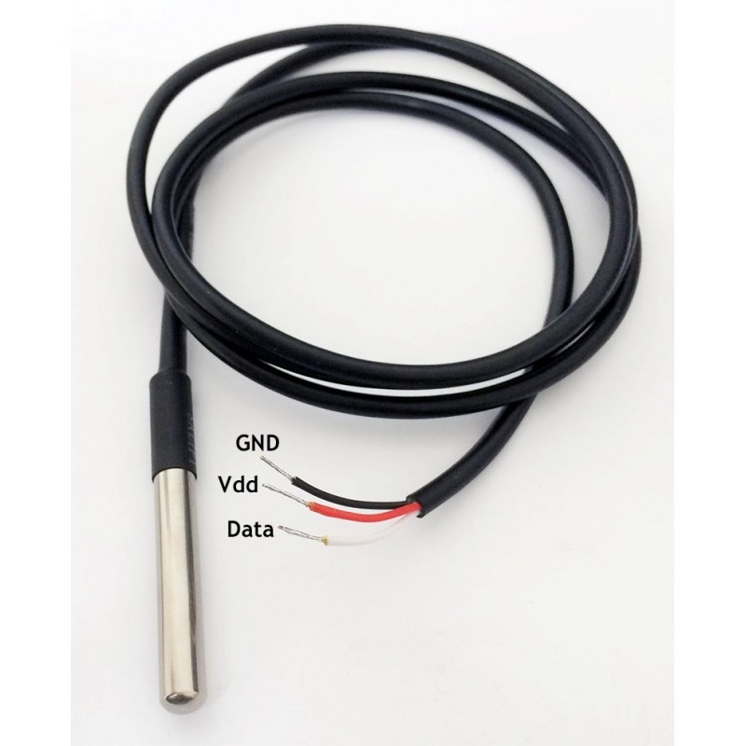
Water temperature sensor
(Specifications,Working principle,Datasheets)
This is a pre-wired and waterproofed version of the DS18B20 sensor. Handy for when you need to measure something far away, or in wet conditions. While the sensor is good up to 125°C the cable is jacketed in PVC so we suggest keeping it under 100°C. Because they are digital, you don't get any signal degradation even over long distances! These 1-wire digital temperature sensors are fairly precise (±0.5°C over much of the range) and can give up to 12 bits of precision from the onboard digital-to-analog converter. They work great with any microcontroller using a single digital pin, and you can even connect multiple ones to the same pin, each one has a unique 64-bit ID burned in at the factory to differentiate them. Usable with 3.0-5.0V systems.
Usable temperature range: -55 to 125°C (-67°F to +257°F)
Specifications:
9 to 12 bit selectable resolution
Uses 1-Wire interface- requires only one digital pin for communication
Unique 64 bit ID burned into chip
Multiple sensors can share one pin
±0.5°C Accuracy from -10°C to +85°C
Temperature-limit alarm system
Query time is less than 750ms
Usable with 3.0V to 5.5V power/data

Slide 9
NODEMCU
(Specifications,Working principle,Datasheets)
NodeMCU is an open source IoT platform.It includes firmware which runs on the ESP82866 Wi-Fi SoC from Espressif Systems, and hardware, which is based on the ESP-12 module. The term “NodeMCU” by default refers to the firmware rather than the dev kits. The firmware uses the Lua scripting language. It is based on the eLua project and built on the Espressif Non-OS SDK for ESP82866. It uses many open source projects, such as Lua-cjson and spiffs.
Specifications:
Wi-Fi Module – ESP-12E module similar to ESP-12 module but with 6 extra GPIOs.
USB – micro USB port for power, programming and debugging
Headers – 2x 2.54mm 15-pin header with access to GPIOs, SPI, UART, ADC, and power pinsMisc – Reset and Flash buttons
Power – 5V via micro USB port
Dimensions – 49 x 24.5 x 13mm

Slide 10
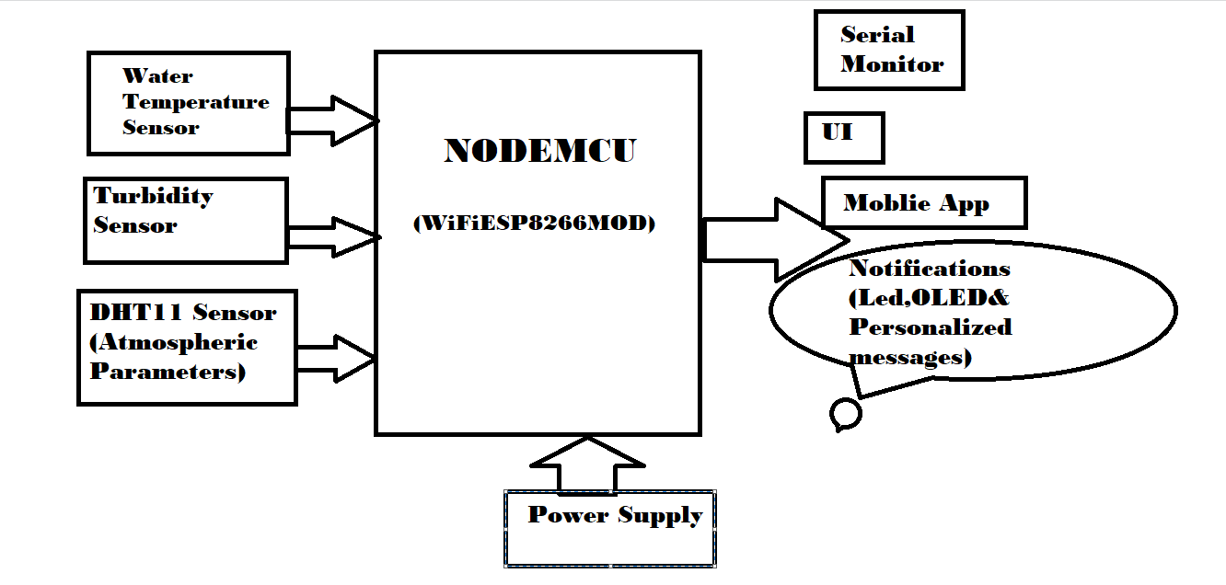

Slide 11
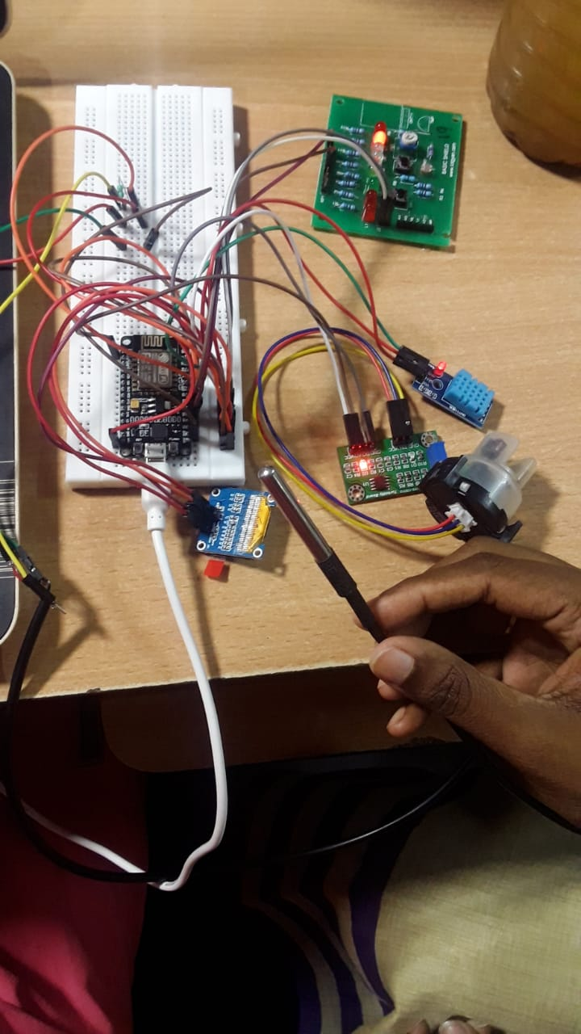

Slide 12
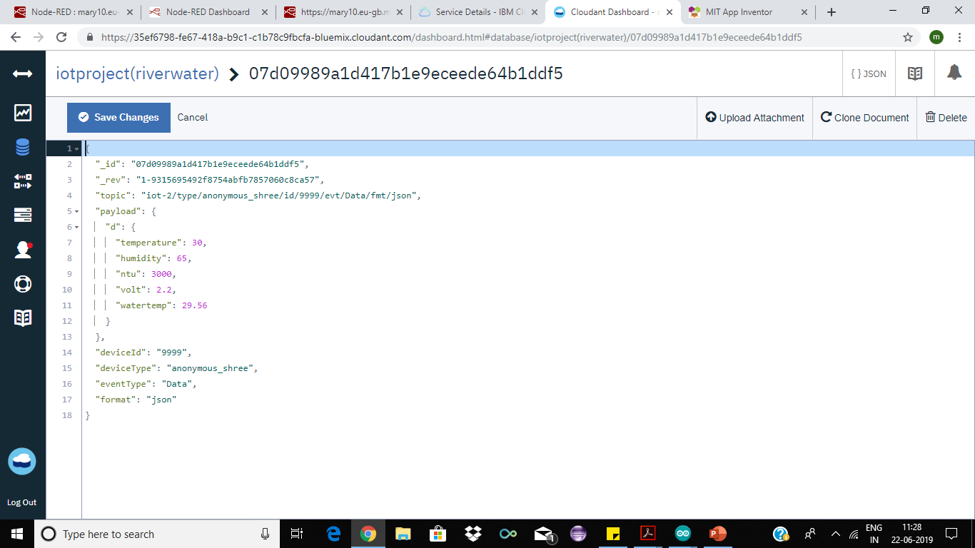

Slide 13
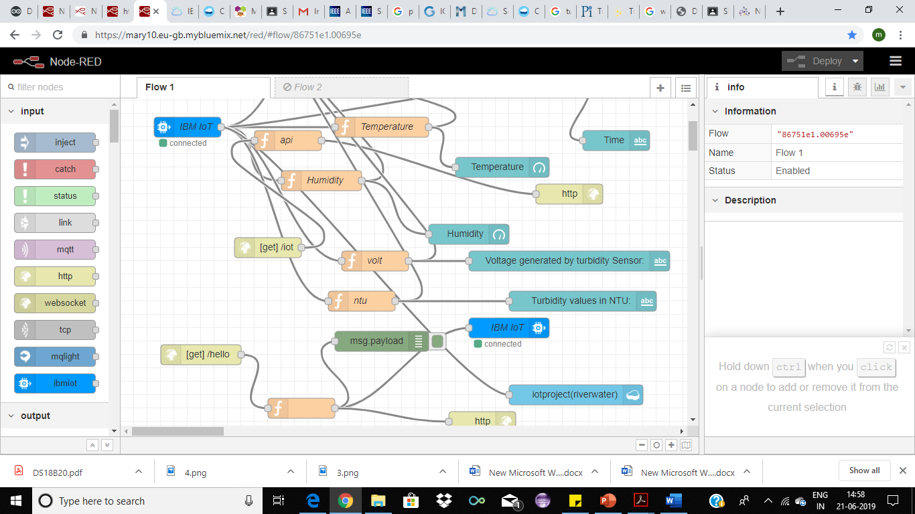

Slide 14
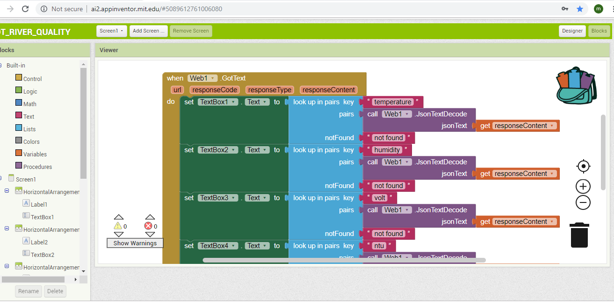

Slide 15
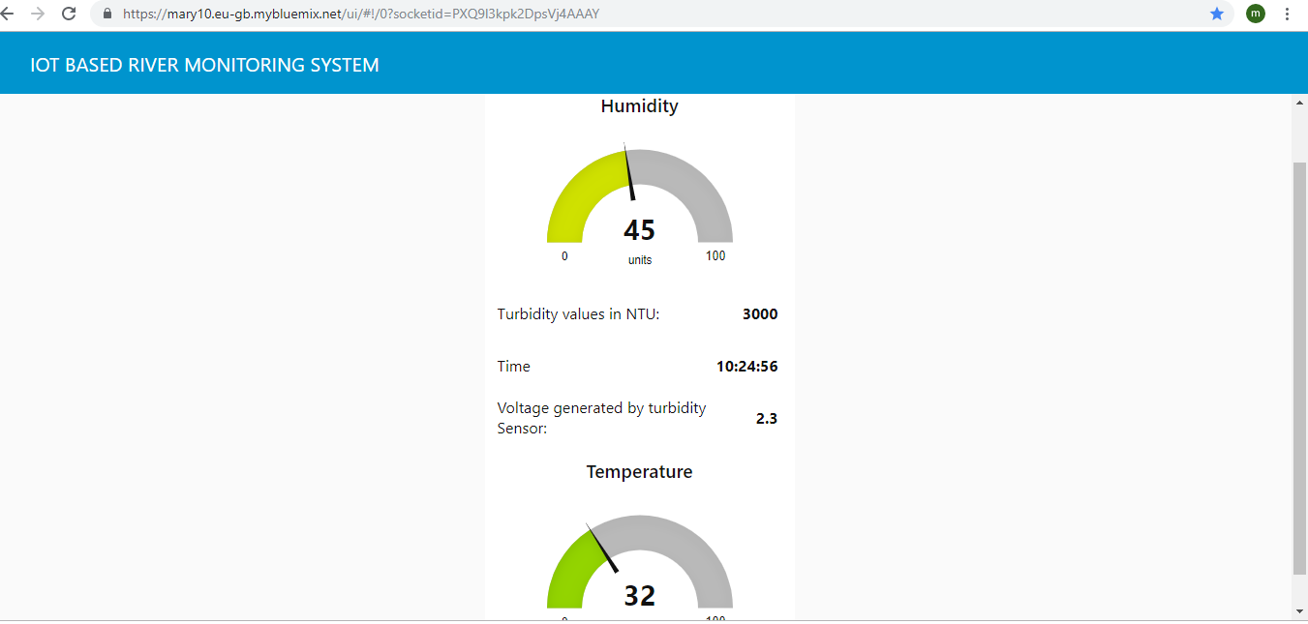

Slide 16
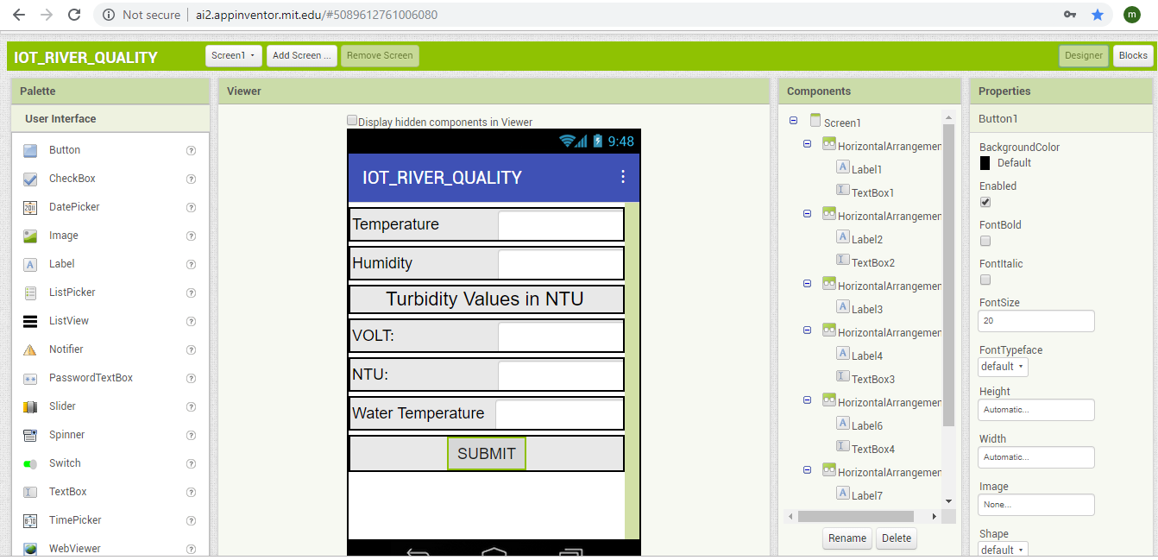

Slide 17
THANK YOU!

